Slide 1


Response to McGrath Support Proposal
NextGen Post Go-Live Managed Services
McGRATH

Slide 2
Executive Summary
BayOne Solutions proposes a governance-led Managed Services Partnership for McGrath RentCorp’s NextGen ecosystem. With five embedded resources already operating within MGRC’s transformation program, BayOne offers the only zero-risk transition in this RFP — eliminating $300–500K in knowledge transfer costs and delivering Day 1 operational readiness across Oracle Fusion, Salesforce, MuleSoft, OIC, and the full integration layer.
Embedded Advantage
Governance-Led MSP
Post Go-Live Focus
Full Stack Coverage
5 resources inside MGRC today — institutional knowledge no competitor can replicate. Zero ramp-up, zero KT risk.
One accountable partner. SLA-driven operations with strategic, tactical, and operational governance tiers.
Hypercare → Stabilization → Optimization. Phased model designed for MGRC’s July 2026 MVP go-live.
13 solution towers. Oracle Fusion, Salesforce CPQ, 70+ integrations, NexSTAR, BI, and infrastructure.
Proposed Value: 3-year engagement with progressive cost optimization — 20% savings in Year 2, 27% in Year 3 — through automation, process maturity, and multi-skilling.
2

Slide 3
About BayOne Solutions
13+
100+
800+
750+
Years in Business
Enterprise Customers
Technology Professionals
Projects Delivered
Technology Services & Innovation
Enterprise Client Portfolio
BayOne is a Bay Area-headquartered technology services firm delivering managed services, application development, cloud engineering, AI/ML solutions, and quality engineering to Fortune 500 and mid-market enterprises.
Global delivery from USA, Canada, India, Philippines, and Costa Rica with 24/7 coverage capabilities. NMSDC MBE certified diverse supplier.
Cisco • Google • Sephora • Netflix • Waymo
Splunk • Zoom • RingCentral • SAP • Fitbit
Clorox • Albertsons • Sony • Kimberly-Clark
90% of all customers through direct referrals
Inc. 5000 • Top Supplier Awards from Cisco & Google
46% women in delivery • #MakeTechPurple initiative
placing 500+ women in tech careers
3

Slide 4
Our Understanding
McGrath RentCorp’s NextGen Transformation & Support Requirements

Slide 5
High-level NextGen Ecosystem Architecture
12–13 connected systems • 70+ integrations • Complete ecosystem overhaul spanning CRM, ERP, billing, tax, portal & integration layers
Salesforce CRM / CPQ / CLM
280 active users
Oracle Fusion ERP
Finance, SCM, Procurement, O2C
RecVue
Billing & Revenue
→ Quote/Order
→ Billing
↑↓
↑↓
↑↓
INTEGRATION LAYER
MuleSoft (~32 APIs) | Oracle Integration Cloud (~16 flows) | Real-time + Batch | ~5% retry/failure rate
↑↓
↑↓
↑↓
Avalara
Customer Hub
NexSTAR
Snowflake
Oracle BI
Azure DevOps
Tax Engine
Portal (PCI)
Legacy ERP
(VB→Java)
Data Warehouse
FRS/OTBI/BIP
CI/CD
Infrastructure: 5 SQL Servers + 7 Oracle ATP Databases + OCI + Azure | SOX / PCI / NIST Compliance | July 2026 MVP Go-Live
5

Slide 6
13 Solution Towers — Full Scope Coverage
# | Solution Tower | Scope | Status
1 | Oracle Fusion (+FSM, EPBCS, ARCS) | Finance, SCM, Procurement, Mfg, O2C, HCM, Field Service, Planning | Bid
2 | Salesforce (CRM, CPQ, CLM) | 280 active users, Gearset CI/CD, DocuSign, D&B, Zilliant | Bid
3 | Oracle Integration Cloud (OIC) | ~16 integration flows connecting Oracle ecosystem | Bid
4 | MuleSoft | ~32 integrations, API management, Salesforce middleware | Bid
5 | RecVue | Billing & revenue management — complex rental model | Bid*
6 | Oracle Cloud Infrastructure (OCI) | ATP databases, backend SaaS infrastructure | Bid
7 | Oracle BI Tools (FRS, OTBI, BIP) | Financial reporting, ad-hoc analytics, automated distribution | Bid
8 | Snowflake / Rivery / SplashBI / Tableau | Data warehouse, ETL, analytics, visualization | Bid*
9 | Avalara | Tax calculation across Salesforce, NexSTAR, RecVue | Bid
10 | NexSTAR (Custom Legacy ERP) | 30+ year legacy TRS-RenTelco, VB-to-Java conversion | Bid*
11 | SQL Server / Oracle ATP Databases | 5 SQL Servers + 7 ATP databases, 24x7 DBA monitoring | Bid
12 | Customer Hub (nopCommerce) | PCI-scoped customer portal, credit card transactions | Bid*
13 | Azure DevOps | Environment management, CI/CD, deployment services | Bid
Bid = Full coverage Bid* = Specialist staffing refined during Phase 1
6

Slide 7
RFP Scope Summary — Our Understanding
Service Area | Description
Operational Support | Monitoring systems, managing integrations, restarting stuck workflows, ticket management via FreshService
Enhancements | MVP backlog, configuration improvements, changes with <40 hrs per unit effort
Bug Fixes | Post go-live / implementation defects across all 13 solution towers
Quarterly Releases | Oracle Fusion quarterly patches, regression testing, production validation
Integration Support | Monitoring 70+ integrations, root cause analysis, restarting stuck processes across MuleSoft / OIC
Value Added Services | AI & automation to drive support efficiencies, reduce manual effort, improve cycle time
Coverage & SLAs
Out of Scope
5 AM – 5 PM PST business hours | 24-hour P1 on-call
SLA baselines established in Phase 1; compliance from Jan 2027
Engineering development (separate SOW)
Infrastructure / network operations
L0 / L1 triage (retained by McGrath)
7

Slide 8
Proposed Solution
Support Model, Governance Framework & Transition Approach

Slide 9
Transformation Journey
NextGen is a complete ecosystem overhaul spanning front-end CRM, backend ERP, billing, tax, customer portal & massive integration layer:
Today
Tomorrow
Customized environment
Reduced Total cost of ownership
Multiple Integration Layers
• Simplify & Streamline
• Standardize
• Automate
Industry standard processes
Complex systems & processes
Reduced cycle time & no-touch support
Limited Self Serve Capabilities
Enriched customer self service
Limited Scalability
Automated patch testing
Manual quarterly patch testing
Faster time to market
9

Slide 10
High Level Support Process Flow
BayOne End-to-End Ownership — L2 / L3 Resolution
User Support
Email / VM
Create
FreshService
Ticket
L0/L1 Triage
(McGrath)
Assign to
BayOne L2
Acknowledge
& Resolve
Update KB
& Close
▶
▶
▶
▶
▶
Escalation: L2 → L3 (SME) → 3rd Party (Oracle SR / Salesforce / RecVue) → BayOne Management
Automation & self-help opportunities identified to improve cycle time and productivity
Agile support sprints via Jira for enhancements alongside FreshService ITSM ticketing
Knowledge database updated with every resolution — continuous improvement cycle
10

Slide 11
BayOne Escalation Matrix
Escalation Level | Escalate to (Role) | Possible Triggers
Level 1 | Project Manager Program Manager | SLA breach risk, recurring defects, minor timeline delays, resource constraints
Level 2 | Delivery Manager cc: Account Manager | SLA breach, high priority issues not resolved within SLAs, quality issues
Level 3 | Account Manager, Delivery Mgr cc: US Sales Head, CTO | Customer dissatisfaction, formal complaints, contractual risks
Level 4 | CEO, CTO cc: Account Mgr, Delivery Mgr | Strategic account risk, legal/compliance issues, significant financial impact
A structured, multi-level escalation framework ensures rapid issue resolution, clear accountability and proactive risk mitigation.
11

Slide 12
Managed Service Governance & Reporting
Strategic | Quarterly
Tactical | Monthly
Operational | Daily / Weekly
McGrath: Leadership
McGrath: Manager
McGrath: Team
BayOne: Business Relationship Mgr,
Delivery Manager
BayOne: Program Manager,
Project Manager,
Delivery Manager
BayOne: BayOne Support Team,
Leads / Managers
Innovation roadmap (AI, automation)
Business outcomes & values delivered
Overall service performance vs SLAs
Efficiency & Effectiveness
(Automations & improvements)
Resource Planning
SLAs / KPIs performance review
SLA Risks & Issues
Blockers, Dependencies
Open incidents, P1/P2 focus & Quality
12

Slide 13
Shared Responsibility Framework (RACI)
Domain | BayOne | McGrath
L2/L3 Incident Resolution | R / A | I
L0/L1 Triage & Routing | I | R / A
Knowledge Base & Documentation | R / A | C
Quarterly Oracle Patch Testing | R / A | C / I
Enhancement Backlog Prioritization | C | R / A
Integration Monitoring (MuleSoft/OIC) | R / A | I
Production Environment Access | C | R / A
SLA Reporting & Metrics | R / A | I
3rd Party Vendor Coordination | R | A
Security & Compliance (SOX/PCI) | C | R / A
R = Responsible A = Accountable C = Consulted I = Informed
13

Slide 14
Phase 1 — Discovery Phase & Transition
Preliminary
Knowledge
Acquisition
Shadow
Support
Reverse Shadow
& Ownership
Week 1–2
Week 3–6
Week 7–10
Week 11–13
Kickoff, access setup,
documentation review,
risk assessment
Architecture review,
integration assessment,
test case execution
Observe incumbents,
document processes,
clarify gaps
Handle live tickets,
receive feedback,
SLA adherence
BayOne Responsibilities
McGrath Responsibilities
Knowledge acquisition & documentation
Shadow & reverse-shadow execution
Process gap identification
SLA baseline establishment
Automation opportunity assessment
Facilitating knowledge transfer sessions
Environment & infrastructure access
Collaborative support with incumbent
Monitoring progress & providing feedback
Stakeholder availability for discovery
14

Slide 15
Proposed Discovery Sprint — BayOne Investment
BayOne proposes a 3–5 day on-site discovery sprint at McGrath Livermore — at our investment — to validate scope, baseline complexity, and de-risk the engagement before contract finalization.
Day 1–2
Day 3
Day 4–5
Deep Dive
Process Mapping
Readout & Baseline
System architecture walkthroughs with MGRC technical leads. Integration inventory validation (MuleSoft/OIC). Document undocumented customizations — the #1 risk identified.
Shadow current support workflows. Map ticket routing logic. Identify automation quick wins for FreshService and integration monitoring.
Present findings to Garni’s team. Deliver refined staffing model based on actual complexity. Propose phased SLA targets grounded in data, not assumptions.
Why this matters: No other vendor will invest their own time to validate scope before asking MGRC to commit. This sprint replaces guesswork with data — and demonstrates BayOne’s confidence in our embedded advantage.
15

Slide 16
Operational Maturity & Value Transformation
On-Board
Stabilize
Optimize
Steady State
Phase 1 | Q1
Y1 Q1–Q4
Y2 Q1–Q4
Y3 Q1–Q4
Onsite: 9
Onsite: 9
Onsite: 6
Onsite: 3
Offshore: 3
Offshore: 22
Offshore: 20
Offshore: 20
Transition:
knowledge acquisition
~3,300 tickets +
1,500 enh hrs / qtr
~2,500 tickets +
2,000 enh hrs / qtr
~1,800 tickets +
3,000 enh hrs / qtr
Support: 90%
Support: 85%
Support: 70%
Enhancement: 10%
Enhancement: 15%
Enhancement: 30%
BayOne handles ±5% spikes • Burst capacity available • Resource counts indicative (managed services, excl. PMO) • Progressive shift from support to enhancements
16

Slide 17
Proposed Coverage
Location | Roles | Responsibilities
Onsite (USA) | Functional SMEs – Fusion, Salesforce, Mulesoft, Avalara, RecVue, BI Program Manager (USA), Project Manager (India) Custom Apps (Customer Hub, NexSTAR), Technical Support Engineers | Managing critical incidents & urgent issues Collaborating with end users & business teams Process mgmt, communication, metrics, risk & issues
Offshore (India) | L2/L3 Support Engineers QA & Testing Engineers Integration Monitoring Team | Resolving tickets & documentation updates Playbook & runbook creation, minor enhancements Monitoring
100% of governance, SMEs & Business Engagement Mgrs during 5 AM – 5 PM PST. 80% of engineers in same window. BayOne Pleasanton to McGrath Livermore — 15 minutes.
17

Slide 18
AI & Automation Enablement
Three-Horizon Roadmap for Intelligent Operations

Slide 19
AI & Automation — Three-Horizon Roadmap
Horizon 1
Horizon 2
Horizon 3
Months 1–6
Months 6–12
Year 2+
Operational Efficiency
Process Intelligence
Transformation
FreshService ticket auto-classification & routing
Integration failure alerting & auto-restart
Automated Oracle quarterly patch regression testing
Knowledge base auto-population
Predictive ticket volume forecasting
Intelligent invoice matching & reconciliation
Self-service portal enhancements (Customer Hub)
Automated MBR/QBR report generation
NexSTAR legacy code modernization via AI agents
Predictive cash flow analytics (CFO office)
Agentic AI for process orchestration
Conversational support BOTs for end users
Led by Colin Moore, Director of AI • Enterprise AI/ML at Coherent Corp • CI/CD automation & legacy UI conversion for Cisco • BayOne’s AI practice leader
19

Slide 20
Metrics & Reporting
Category | KPIs
Cost | Budget conformance • Effort variance • Productivity improvement • Cost per case
Quality | % First Time Resolution • % Tickets reopened • CSAT ratings • Enhancement defect leakage
Time | % SLA adherence • Schedule variance • MTTR • Case age
Phase 1: Define KPIs with McGrath | Phase 2 (H2 2026): Baseline & track | Jan 2027+: Full SLA compliance with remedies
20

Slide 21
Key Assumptions
1. Monthly ticket volume ~1,400 L2/L3; complexity: 30% simple, 50% medium, 20% complex
2. Resolution: Simple 1 hr, Medium 3 hrs, Complex 8 hrs. P1/P2 <10%, P3/P4 >90%
3. Phase 1 baselines actuals. Deviations (±10%) trigger change request
4. All functional stakeholders available during Phase 1 discovery
5. Production-replica environment available for troubleshooting
6. Most MuleSoft integrations migrating to OIC; pricing reflects post-migration
7. Structured KT and handover documentation from incumbent
8. 3rd-party vendor coordination (Oracle, Salesforce, RecVue, Avalara)
9. Ticketing tools, documentation, communication channels from Day 1
10. COLA applicable per contract terms
21

Slide 22
Risks & Mitigation
Risk | Mitigation
KT & Documentation | McGrath facilitates KT plan; BayOne’s embedded team minimizes dependency
Infrastructure Access | Infra teams provide environment access & approvals; delays tracked as risk
Ticket Volume Uncertainty | Phase 1 baselines actuals; phased pricing with adjustment mechanisms
Integration Stability | Robust monitoring; shadow & reverse shadow validate health
Geopolitical Scenarios | BayOne operates from USA, Canada, Philippines, Costa Rica & India
Attrition Knowledge Gap | Succession planning, contingent pool, KM reduces dependency
Incumbent Knowledge | BayOne embedded at MGRC; rebadging critical resources with approval
22

Slide 23
Key Asks from McGrath
KT Facilitation
Knowledge sharing facilitated by McGrath; KT plan co-developed for structured transition from incumbent
Infrastructure Support
Environment setup, system access, and approvals provided by McGrath infrastructure teams in a timely manner
Information Sharing
All information required for support operations shared by incumbent. Delays beyond reasonable time may impact SLAs
Sign-offs & Approvals
Entry/exit criteria sign-offs, all necessary approvals, software licensing, and timely access provisioning
23

Slide 24
Case Studies
Relevant Enterprise Engagements

Slide 25
Case Study — Oracle Fusion Cloud HCM Implementation
Business Scenario
Technologies
National security agency. Complex multi-category workforce. Fragmented legacy systems. End-to-end Oracle Fusion Cloud HCM: Core HR, Payroll, Absence, Talent, Learning, Recruiting. 30,000+ records migrated.
Oracle Fusion Cloud HCM, OIC, Oracle Analytics Cloud, VBCS, Oracle Content Mgmt, OCI, Identity Cloud (RBAC, MFA). SIT, UAT, payroll parallel run.
75%
98.6%
78%
93%
Faster Payroll
(12→3 days)
Data Accuracy
Self-Service
Adoption (3 mo)
Payroll Error
Reduction
25

Slide 26
Case Study — Oracle Fusion HCM Managed Services
Post-implementation managed services. SLA-driven incident management (P1–P4), quarterly updates, 260 enhancement hours, security governance, knowledge base, performance optimization.
95.7%
100%
99.8%
87%
SLA Compliance
P1 Adherence
System Uptime
User Satisfaction
Case Study — Oracle EBS Support (12+ Year Partnership)
Global leader in materials & laser technologies. 30+ sites. EBS 11i→R12 upgrade, M&A mergers, Finance/HCM/Procurement/WMS. 25+ BIP reports. Oracle Cloud advisory.
26

Slide 27
Case Study — Enterprise IT Operations Transformation
Challenge
Results
End-to-end front/back office for enterprise contingent worker program. SOW renewals, onboarding, invoice mgmt, incident resolution. L1/L2, 99% SLA requirement.
Centralized ops, real-time analytics, automation.
• 20% cost optimization Day 1
• Seamless transition
• 15% manual effort reduction
• Enhanced efficiency & CX
>4.4
>5K
>95%
100+
CSAT Score
Tickets / Qtr
SLA Adherence
Apps Supported
27

Slide 28
Your BayOne Team
Proposed Account Management Structure & Key Biographies

Slide 29
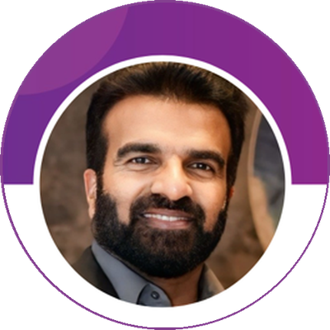

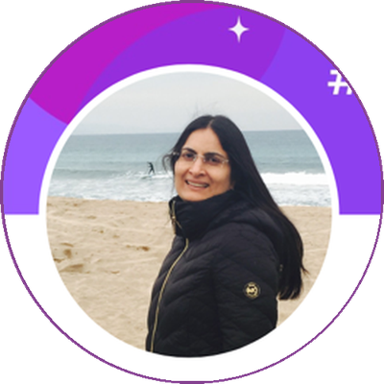

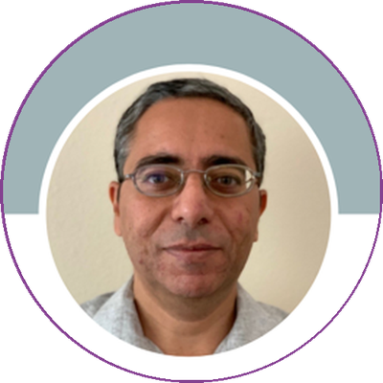
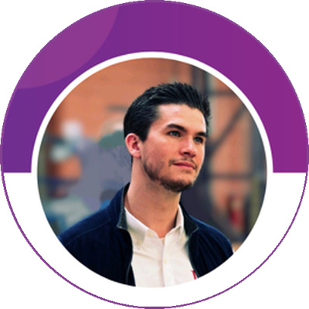
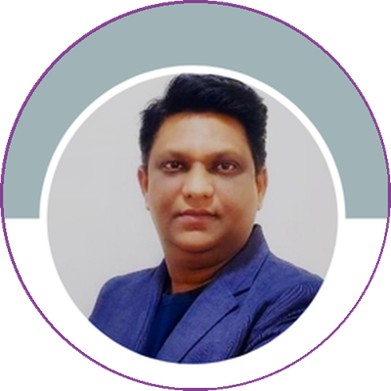
Proposed Account Management Team
Executive Sponsor
Account Owner
Technical Exec Sponsor
Surej KP
Neha Malhotra
Sripriya K.
CEO
VP, Growth & Customer Success
CTO
Sr. Relationship Manager
Delivery Manager
Head of AI
Governance Lead
Zahra Syed
Amit Grover
Colin Moore
Kishore Elimineti
Co-Account Owner
VP, Solutions & Delivery
Director of AI
Program Leader
Governance & Review Cadence
Cadence | Participants | Focus
Weekly | Kishore + MGRC leads | Operational review, ticket health, SLA tracking
Monthly | Neha + Amit + MGRC management | Service delivery, CSAT, resource planning
Quarterly | Neha + Surej + Sripriya + MGRC VP | Strategic review, transformation roadmap
Annual | Full leadership team | Partnership roadmap, long-term planning
29

Slide 30
Key Team Biographies
Neha Malhotra
Account Owner | VP, Growth & Customer Success
25 years proven delivery across technology services, enterprise account leadership, and business operations. Founding BayOne team member, scaling company to $80M+ revenue. Fortune 500 relationships across technology, retail, industrial. Deep knowledge of MGRC’s business, stakeholders, and NextGen. Founded #MakeTechPurple, 500+ women in tech. San Jose State University.
Zahra Syed
Sr. Relationship Manager | Co-Account Owner
Enterprise account leader building trust-based C-level partnerships. Strong personal relationships with MGRC’s senior IT leadership over multiple years. Unique insight into organizational priorities and decision-making. Day-to-day bridge between BayOne delivery and MGRC. UC Irvine.
Surej KP
Executive Sponsor | CEO & Board Member
Proven technology executive. Previously CEO Intelliswift Software; CTO & President UST Global; Practice Head Cognizant; Regional Director TCS. Harvard Executive Leadership Development Program. C-suite escalation access with personal commitment to MGRC partnership.
Amit Grover
Delivery Manager | VP, Solutions & Delivery
Seasoned delivery executive. Previously Sr. Regional Director HCL Technologies (70+ professionals); Sr. Manager Infosys (Supply Chain, Finance); Service Delivery Manager Zensar ($25M+ IT Ops). Based at BayOne Pleasanton. BITS Pilani. MGRC delivery escalation point.
30

Slide 31
Key Team Biographies (continued)
Sripriya Kalyanasundaram
Technical Executive Sponsor | CTO
Technology leader advising C-level executives on digital transformation through human-centered design thinking. Harvard Business School. Previously President LambdaTest; Deloitte Consulting; SVP UiPath; Global Delivery Leader Cognizant Digital Business. AI-first mindset champion. Executive technical oversight for MGRC.
Colin Moore
Head of AI & Innovation | Director of AI
Leads BayOne’s AI practice. Previously AI/ML Manager Coherent Corp. Core expertise: AI, LLMs, Deep Learning, Intelligent Process Automation. Delivered CI/CD pipeline automation and legacy UI conversion for Cisco. Leads three-horizon AI enablement roadmap for MGRC. Duquesne University.
Kishore Elimineti
Governance Program Lead | Program Leader
Enterprise ERP, Cloud, AI Strategy & Transformation Leader. $100M+ programs including end-to-end Oracle Fusion Cloud implementations. Former Oracle Corporation — Fusion Cloud at Redwood City, SAFe adoption, $5.3B Micros M&A integration. Oracle Fusion Cloud migrations at Albertsons. Currently embedded at MGRC leading NextGen transformation. Indian School of Business.
31

Slide 32
Commercials
Managed Services Investment Summary

Slide 33
Managed Service Commercials
Phase 1 | Year 1 | Year 2 | Year 3 | Total
$738,400 | $4,867,200 | $3,889,600 | $2,828,800 | $12,324,000
Year 2 Savings
20%
Year 3 Savings
27%
Driven by automation, process maturity,
and multi-skilling efficiencies
Bundled managed services pricing. Individual components may vary.
BayOne investing shadow resources during transition at no additional cost.
Pricing based on assumptions; actuals baselined during Phase 1.
33

Slide 34
What Sets BayOne Apart
Typical MSP Vendor
BayOne for McGrath
3–6 month KT ramp
vs
Zero KT risk — 5 embedded resources already inside MGRC
No institutional knowledge
vs
$300–500K saved in transition costs from Day 1
Remote delivery center
vs
HQ in Pleasanton, CA — 15 min from Livermore
Generic staffing approach
vs
Governance-led MSP with tiered SLA accountability
Bid-and-run model
vs
Discovery sprint investment before contract finalization
Checkbox diversity
vs
46% women in delivery, 500+ women placed via #MakeTechPurple
One-size-fits-all pricing
vs
Phased model with progressive 20–27% YoY optimization
34

Slide 35
#MakeTechPurple Initiative
Bridging the gender divide in tech through dynamic upskilling and reskilling programs, ensuring women secure and thrive in lasting tech careers.
500+
26%→46%
NMSDC
2%
Women Placed
in Tech Careers
Women Hiring
Rate Growth
MBE Certified
Diverse Supplier
Veterans in
Workforce
Community Cohorts
Girl Empowerment
BayOne Delivery Impact
10–15 women from underserved communities receive 1–3 months of pro-bono technical training in AI and Software Engineering through enterprise partnerships.
Partnering with Pleasanton USD to mentor middle & high school girls. Apprenticeships and scholarships to Girls Who Code, nurturing the next generation.
Fair selection processes, Rooney Rule, and AI-powered diverse sourcing grew women’s hiring from 26% to 46% in four years. Diversity is embedded in our delivery DNA.
35

Slide 36
The Only Vendor With
Day 1 Operational Readiness
5
$0
15 min
Embedded resources inside
MGRC’s NextGen program today
Knowledge transfer risk.
No other bidder can claim this.
BayOne Pleasanton to
McGrath Livermore
Neha Malhotra | VP, Growth & Customer Success | neha.malhotra@bayone.com
Confidential | March 2026

